Slide 1
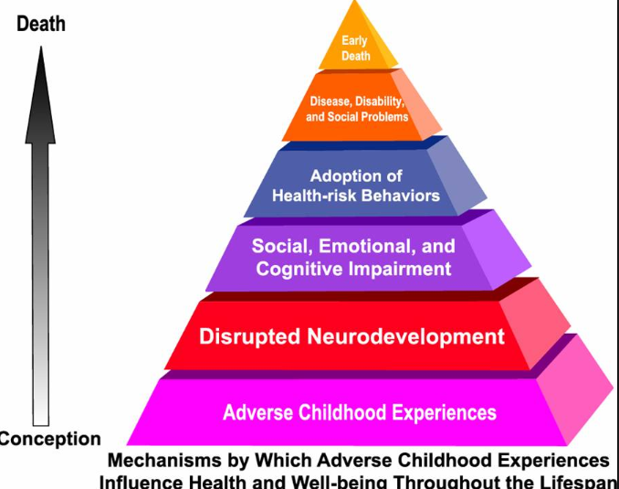
Adverse Childhood Experience’s (ACE)
Implications for the classroom
Adapted from: Stewart, Altha J. University of Tennessee Health Science Center. March 7, 2016

Slide 2
Agenda
Introduction
Objective: Participants will:
Learn the impact of trauma on the brain and the implications that it has in the classroom
Discuss trauma-sensitive practices and procedures
Take the Ace Assessment
ACE – How it impacts your Health
ACE – How it impacts learning
What does a trauma sensitive school/classroom look like
Resilience
Adverse childhood experiences (ACEs) of abuse, neglect and family dysfunction between birth and age 18 can disrupt brain development and limit social, emotional and cognitive functioning.
ACEs are the root cause of many serious academic, social and behavioral problems that have the potential to prevent a child from receiving the full benefits of education

Slide 3
Share with a neighbor What types of trauma, have your students experienced. To what extent does it affect their learning?

Slide 4
Take the ACE’s assessment

Slide 5
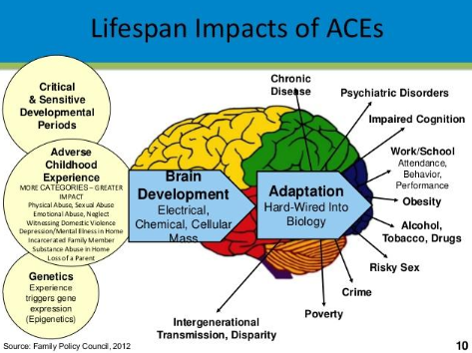
Ace’S Findings
ACEs are surprisingly common
ACEs still have profound effect 50 years later
Transformed from psychosocial experience into physical diseases, social dysfunction and mental illness
ACEs are the main determinant of the health and
social well-being of the nation.

Slide 6
Adapted from Childrens Trust of South Carolina. https://scchildren.org/prevention_learning_center/adverse_childhood_experiences_aces/

Slide 7
Adapted from Childrens Trust of South Carolina. https://scchildren.org/prevention_learning_center/adverse_childhood_experiences_aces/

Slide 8
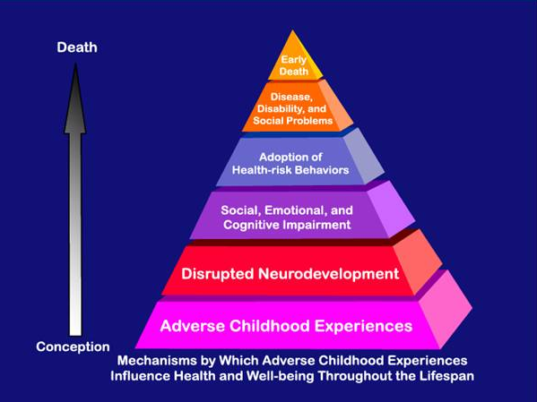

Slide 9
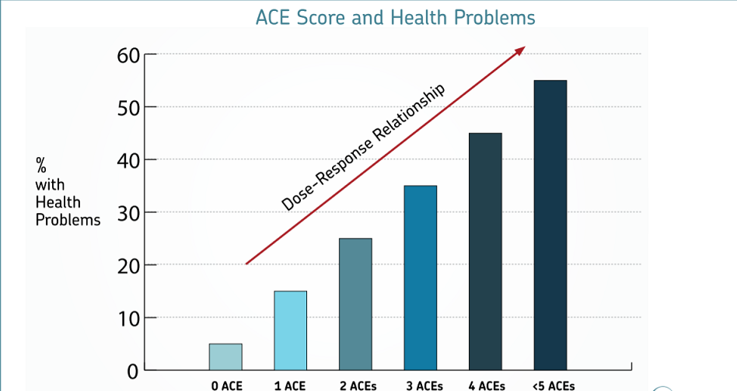
Adapted from Childrens Trust of South Carolina. https://scchildren.org/prevention_learning_center/adverse_childhood_experiences_aces/

Slide 11
Adapted from Childrens Trust of South Carolina. https://scchildren.org/prevention_learning_center/adverse_childhood_experiences_aces/

Slide 12
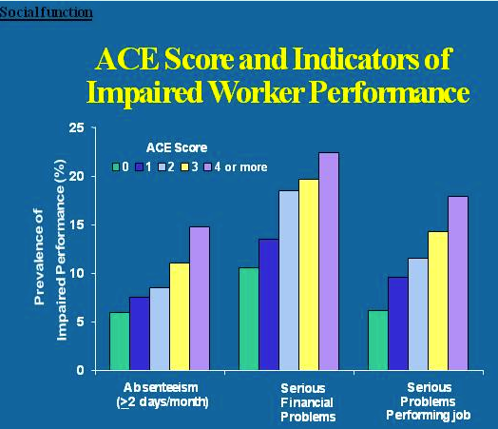

Slide 13
Share with a neighbor How does ACE’s impact your family & community Is there anything you can do about it.

Slide 14
Impact on Child Development
The ability to form healthy relationships is highly dependent on learned social skills
Children’s social skill learning is directly related to the characteristics of their environments
Violence teaches withdrawal, anxiety, distrust, over-reaction and/or aggression as coping behaviors
Disordered environments=dysfunctional skills

Slide 15
Children & Traumatic Events
Over half the children in the US are exposed to violence, crime and abuse every year
26% will witness or experience a traumatic event before the age of 4
Exposure to violence in any form harms children and can have many negative effects throughout childhood and into adulthood.
We spend over $100 billion on problems related childhood abuse and trauma (physical, emotional, legal, etc.)

Slide 16
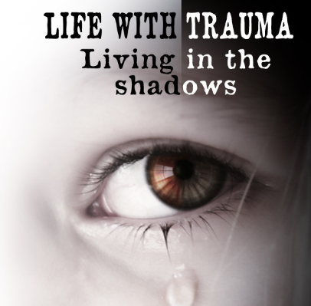
Trauma
Trauma does not automatically cause PTSD (25% risk), violation/degradation/betrayal increases risk to 50-75+%
Trauma is Epidemic in 60% of Adults and 50% of Children
Trauma is almost universal for boys (93%) and girls (87%) in the JJ System
Trauma increases the risk of further trauma (most survivors have at least 2 distinct trauma
Life with Trauma. Retrieved from: https://www.steampoweredfamily.com/brains/life-with-trauma/

Slide 17
Trauma
By adolescence, children have sufficient skill and independence to seek relief through the following:
Drinking alcohol
Smoking tobacco
Sexual promiscuity
Using psychoactive materials
Overeating/eating disorders
Delinquent behavior

Slide 18
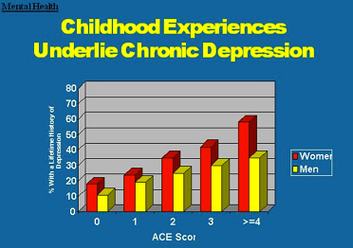
Adapted from Childrens Trust of South Carolina. https://scchildren.org/prevention_learning_center/adverse_childhood_experiences_aces/

Slide 19
Adapted from Childrens Trust of South Carolina. https://scchildren.org/prevention_learning_center/adverse_childhood_experiences_aces/

Slide 20
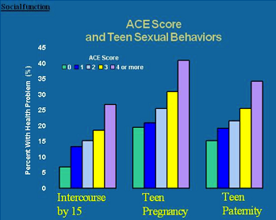
Adapted from Childrens Trust of South Carolina. https://scchildren.org/prevention_learning_center/adverse_childhood_experiences_aces/

Slide 22
Adapted from Childrens Trust of South Carolina. https://scchildren.org/prevention_learning_center/adverse_childhood_experiences_aces/

Slide 23
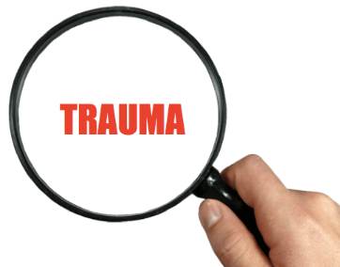
Traumatized Children
World is punitive, judgmental, humiliating and blaming
Control is external, not internalized
People are unpredictable and untrustworthy
Defend themselves above all else
Believe that admitting mistakes is worse than telling truth

Slide 24
Prevalence of indicators of negative well-being, by number of adverse childhood experience (12-17)
Measure of well being | 0 ACEs | 1 ACEs | 2 ACEs | 3+ ACEs
High externalizing behavior | 18% | 26% | 33% | 41%
Low engagement in school | 25% | 33% | 44% | 48%
Household contacted due to problems at school | 13% | 23% | 31% | 38%
Grade repetition | 6% | 12% | 14% | 21%
Does not stay calm and controlled | 24% | 34% | 40% | 44%
Does not finish tasks started | 27% | 36% | 44% | 49%
Diagnosed with a learning disability | 9% | 13% | 16% | 23%
Fair or poor physical health | 2% | 4% | 4% | 6%
Adapted from Childrens Trust of South Carolina. https://scchildren.org/prevention_learning_center/adverse_childhood_experiences_aces/

Slide 26
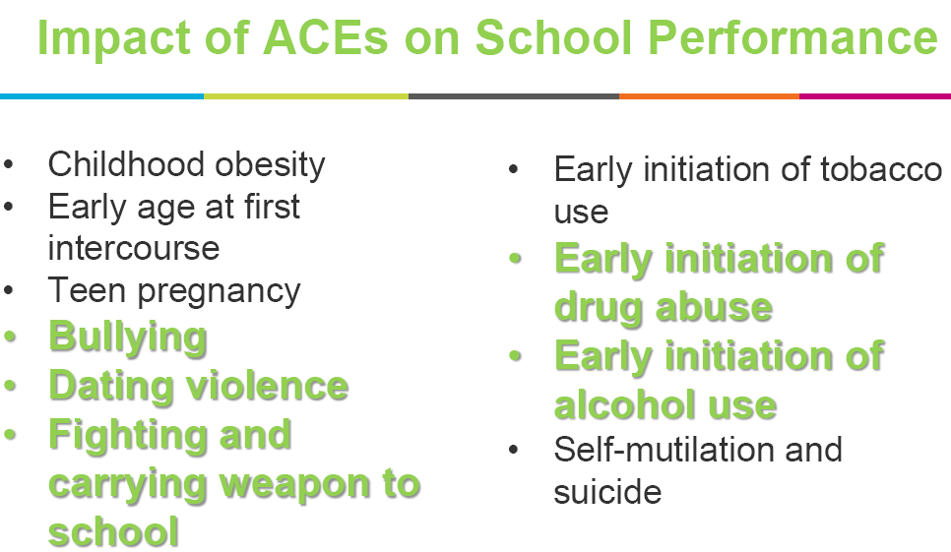

Slide 27
Share with a neighbor How does this information change how you will view your students?

Slide 28
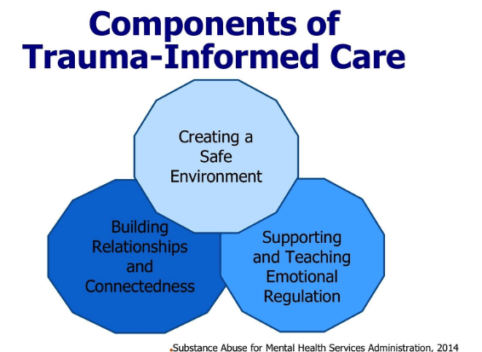
What does a trauma informed classroom/School look like?
Shifts in mindsets (e.g. moving away from reactive to more proactive approaches or moving away from
punitive disciplinary approaches toward teaching social and self-regulation skill building)
Moving toward problem-solving more quickly after identifying a concern
Increase in trauma-sensitive problem-solving (e.g. increased curiosity and discussion about the underlying causes of challenging behavior)
Teachers sharing effective strategies with one another more frequently
Improvements in collaborations among school staff (increased teamwork)
It is important to note that most schools collect a wide range of quantitative data and the existing data can be used. It not necessary to generate new quantitative measures.
Examples include:
Staff and student surveys
Decreases in crisis calls
Decreases in numbers of office referrals for punitive disciplinary reasons
Reductions in chronic attendance issues/ improvements in attendance
Decreases in reports of bullying

Slide 29
Adapted from Childrens Trust of South Carolina. https://scchildren.org/prevention_learning_center/adverse_childhood_experiences_aces/

Slide 30
Protective Factors - Resilience
Strengths-based approach to supporting children that incorporates natural supports (“the village”), services (“treatment, support, advocacy”), and skills building related to self-advocacy, education and empowerment
Work from a “needs” base, not a problem (“deficit”) focus

Slide 31
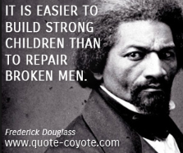

Slide 33
https://www.cdc.gov/violenceprevention/acestudy/index.html
https://www.npr.org/sections/health-shots/2015/03/02/387007941/take-the-ace-quiz-and-learn-what-it-does-and-doesnt-mean
https://www.childtrends.org/publications/prevalence-adverse-childhood-experiences-nationally-state-race-ethnicity
Murphey, David. The prevalence of adverse childhood experiences, nationally, by state, and by race or ethnicity.
Retrieved from: https://www.childtrends.org/staff/david-murphey-2
Strompolis, Melissa. South Carolina Adverse Childhood Experiences Initiative. www.scchildren.org/aces. July 10, 2017.
Retrieved from: https://scchildren.org/research/adverse-childhood-experiences/

