Slide 1
La Sierra University and
Title IX
Dr. Laurel E. Brown, Title IX Coordinator

Slide 2

Our Desire for you
SAFETY
FRIENDSHIPS
FUN
DISCOVERY
LOVE
PURPOSE

Slide 3
Our Goal – Safe healthy relationships = safe healthy community
To create an atmosphere of Respect, Wholeness and Safety where learning, personal and professional development can flourish.
To encourage those in our community to interact in a way that is respectful, healthy and safe for all.
To ensure that you have the information, resources and services needed when we fall short of those goals.

Slide 4
Title IX
Title IX of the Education Amendments of 1972 prohibits discrimination on the basis of sex/gender in any federally funded education program or activity.
Under Title IX, schools have the responsibility to take immediate and effective steps to respond to sex/gender based discrimination, sexual harassment, including sexual violence in accordance with the requirements of Title IX.

Slide 5

La Sierra University’s
Sexual misconduct policy

Slide 6
Our Policy
What are the boundaries to healthy sexual conduct?
What behaviors cross those boundaries?
What are the procedures for addressing reports of sexual misconduct?

Slide 7
Boundaries for Healthy sexual conduct
No discrimination on the basis of sex, gender in any educational program or activity = equal opportunity to participate.
Verbal and non-verbal conduct that is respectful of difference and does not create a hostile, offensive or intimidating environment = all can participate without fear, humiliation, pressure to conform.
All sexual contact is consensual, involving adults who are alert, and actively engaged = healthy communication about wants, limits and boundaries.
Relationships are reciprocal, without the abuse of power or use of force = mutual respect and valuing of each other and the relationship.

Slide 8

Behaviors that cross those boundaries
Sex/Gender-based Discrimination
Sexual Harassment –
    Quid Pro Quo (this for that)
    Hostile Environment
Sexual Violence – (a form of sexual harassment)
    Sexual Assault – non-consensual contact
    Intimate Partner Violence- dating and domestic violence.
    Sexual Exploitation
    Stalking
Notes:
Sexual Assault: Sexual assault is any type of any sexual contact or behavior that occurs without the explicit consent of the recipient. Falling under the definition of sexual assault are sexual activities, such as forced sexual intercourse, forcible sodomy, child molestation, incest, fondling, and attempted rape. (http://www.justice.gov/ovw/sexual-assult)
B. Sexual Exploitation: Taking sexual advantage of another person for the benefit of oneself or a third party when consent is not present.
C. Stalking: A course of conduct directed at a specific person that is unwelcome and that would cause a reasonable person to fear for their safety (or the safety of a third party) or suffer substantial emotional distress.
D. Dating/Domestic Violence: Intimidation, harassment, physical abuse, sexual abuse, or interference with personal liberty of any person by someone in an intimate relationship with that person.
E. Sexual Harassment: Sexual harassment is any unwelcome conduct of a sexual nature when sexual favors are used or threatened to be used as a basis for academic or employment decisions (quid pro quo harassment); when the conduct creates a hostile, intimidating or offensive academic or working environment; when the conduct has the effect of unreasonably interfering with an individual’s work performance; or when other verbal, nonverbal, or physical conduct of a sexual nature is sufficiently severe, persistent, or pervasive to limit a person's ability to participate in or benefit from an educational program or activity.
All forms of sexual misconduct identified in this policy are also prohibited forms of sexual harassment.

Slide 9
Sexual Harassment
Sexual harassment is any unwelcome conduct of a sexual nature;
  Quid Pro Quo (this for that)
    when sexual favors are used or threatened to be used as a basis for academic or employment decisions;
  Hostile Environment,
    when the conduct creates a hostile, intimidating or offensive academic or working environment;
    when the conduct has the effect of unreasonably interfering with an individual’s school or work performance;
    or when other verbal, nonverbal, or physical conduct of a sexual nature is sufficiently severe, persistent, or pervasive to limit a person's ability to participate in or benefit from an educational program or activity.

Slide 10
Sexual Harassment / Sexual Violence
A. Sexual Assault: Sexual assault is any type of any sexual contact or behavior that occurs without the explicit and affirmative consent of the recipient..
B. Sexual Exploitation: Taking sexual advantage of another person for the benefit of oneself or a third party when consent is not present. (includes distributing pictures, recordings or images to others without consent)
C. Dating/Domestic Violence: Intimidation, harassment, physical abuse, sexual abuse, or interference with personal liberty of any person by someone in an intimate relationship with that person.
D. Stalking: A course of conduct directed at a specific person that is unwelcome and that would cause a reasonable person to fear for their safety (or the safety of a third party) or suffer substantial emotional distress.

Slide 11

Other Conduct that Crosses the Line
Title IX also prohibits;
  Retaliation (may include threats, harassment or coercion) against a person for making a good faith report of sexual misconduct.
  Violation of Interim Measures taken to protect the educational and safety rights of the reporting party.

Slide 12
“Yes means Yes” – Affirmative Consent
Incapacity to give consent may include;
  Being under 18 – age of consent
  Being intoxicated, due to drugs, alcohol or other substances.
  Having a cognitive, developmental or mental disability.
Consent requires knowing what you’re saying yes to at all times.
Consent requires actively saying yes, not just that the person didn’t say no.
Consent must be voluntary, not coerced.
Consent must be present and ongoing.

Slide 13

More on Consent

Slide 14

Gauging Consent Activity
3 Audience Volunteers
No Consent – Red Light
Unclear, Ambiguous - Yellow Light
Affirmative Consent – Green Light
Notes:
Red group – What are the No signs or the signs that someone needs to stop sexual activity??
Yellow – What are the signs that one should slow down/pause/check in?
Green – What are the Yes signs or the signs to keep going and communicating?
Have each group list signs on post it chart paper.
Each group share with large group – 15 minutes total
Discussion;

Slide 15
Ryo and Casey
Ryo and Casey are dating. Casey is uncertain about whether they should have sex, but Ryo is persuasive and finally obtains Casey’s voluntary agreement. As they engage in sex, Casey says “wait-stop-that hurts.” Ryo nonetheless continues for several more minutes, restraining Casey. Afterwards, Casey is upset. Ryo apologize, but says they were past the point of interruption.
Notes:
Though initially has consent, Casey clearly rescinds consent to move forward which Ryo ignores. Could lead to expulsion.

Slide 16
Jessie and Vic
Jessie and Vic have been flirting all semester, and agree to meet at a party. After dancing closely together for a while, Vic proposes going to one of their rooms and Jessie agrees. On the walk to Jessie's room, they send a few texts, letting Vic's friends know not to worry and asking Jessie's roommate to please sleep somewhere else. Once in the room, they begin touching. Each is interested in hearing what the other wants, and each is paying attention to the others signals. They reach and sustain clear agreement upon mutually desired sexual activities.
Notes:
Clear communication, clear agreement. Sex with consent

Slide 17
Sidney and Harper
Sidney and Harper are dating. On several occasions they are physically intimate, but within limits set by Sidney, who is opposed to having sex at this stage of their relationship. One night, when they are being intimate within their mutually agreed upon boundaries, Harper begins to cross them. Sidney expresses concern, but Harper is encouraging, saying ”it will be okay just this once.” Sidney replies “we shouldn’t do this,” but continues to touch Harper in an intimate way. As Harper initiates sex, Sidney says “this is a bad idea” and begins to cry, but embraces Harper and the two proceed to have sex.
Notes:
Initial consent followed by ambiguity. No clear yes or ok to proceed. History of opposition to sexual intercourse.

Slide 18
Alex and Riley
Alex and Riley are studying together in Riley’s room. During a break in their studying, they rub each others shoulders. Alex then introduces some intimate touching. Riley moves closer and says “Okay, but I don’t want to go too far – we still have a lot of work to do.” Alex continues to touch Riley in an intimate way. Riley willingly agrees to some contact, but mostly sets boundaries. Alex jokes that they deserve to have sex as a reward for their hard work studying; Riley laughs. After their studying is done, Alex suggests again that they should have sex. Riley responds they should probably gets some sleep but continues to touch Alex. After a few more minutes, Alex asks once more. Riley pauses, then says OK and pulls Alex closer. They have sex.
Notes:
Sex with consent. Alex asks for permission at every juncture. Riley who has been clear with boundaries all night says OK and physically demonstrates agreement to move forward.

Slide 19
Tyler and Jordan
Tyler and Jordan are both drinking heavily at an off campus event. Tyler becomes extremely drunk. Jordan offers to take Tyler home. On the way, Tyler has trouble walking, and makes several wrong turns. Once in Tyler's room, Jordan initiates sexual activity. Tyler looks confused and tries to go to sleep. Jordan has sex with Tyler.
Notes:
No consent due to incapacitation. Could lead to expulsion.

Slide 20
Establishing Consent
Ask for consent
Communicate
Make it fun
Avoid alcohol and drugs
Understand consent can be withdrawn at any time. So, keep checking.

Slide 21
Then What? Your Rights
When these boundaries are crossed you can;
  Report directly to Title IX Coordinator;
  Report to Campus Safety and Security Patrol (24 hours)
  Report to Riverside Police Department
Talk to someone confidentially who will not report (Counseling Center, Health Services, Chaplains Office, Riverside Area Rape Crisis Center)
Refuse to make a police report or notify the University of the incident, or pursue a complaint.
Notes:
While the University strongly encourages reporting, members of the University community who believe they have experienced sexual misconduct have the right to choose whether or not to report the incident to the University or law enforcement and pursue a sexual misconduct complaint with the University.

Slide 22
Once Reported
Process – Confidentiality a priority.
  Assessment with Coordinator
  Fair, prompt and effective investigation
  Transparent process for both parties
  Determination of policy violation and recommended remedies, corrective actions/consequences.
Supports
  Interim protective measures ( if needed)
  Counseling/resources
  Training/Prevention Programs

Slide 23
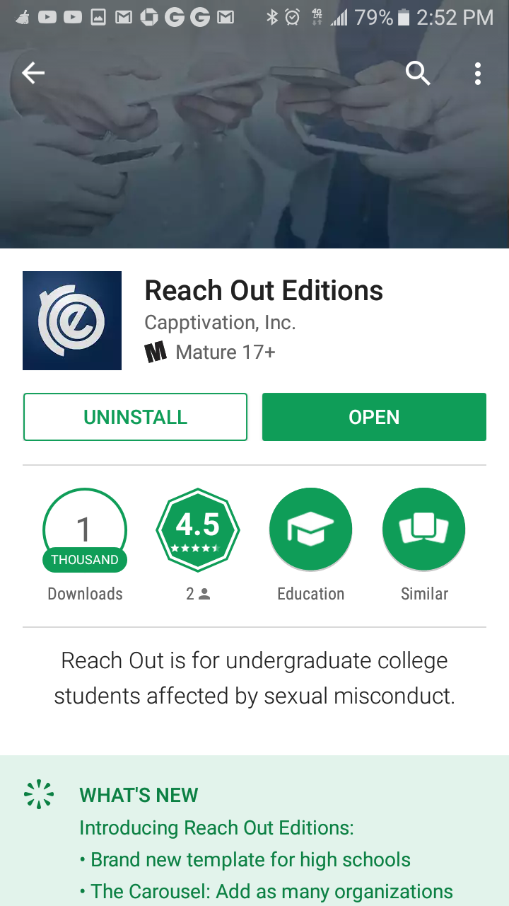
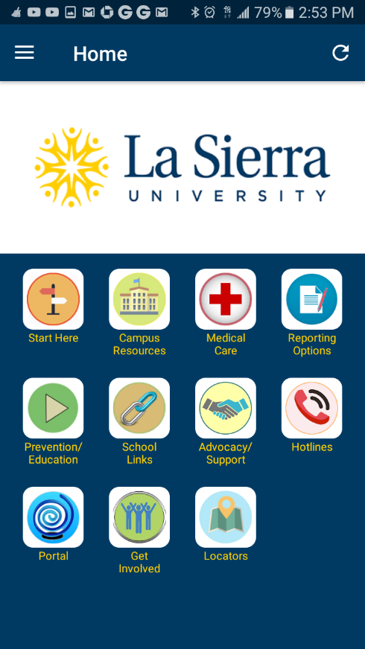
Reach Out Edition-Mobile App
La Sierra Edition
Notes:
On your android or iphone – Available on Google Play and Apple Store- Reach Out Editions, pick La Sierra from University list.

Slide 24

Questions???

